Slide 1
Dan's Bagelry
Developed by High Five Bagels
James Richardson
Dax Thompson
Adam Thomas
Mitch Parsons

Slide 2
Design
When we began the project we had a general understanding of what we wanted the site to look and function like. Speaking from where we are now, we believe we have achieved almost all of what we first set out to do. Most of the changes and shifts in Design and Functionality came about in the third milestone when we began working fully on the program itself and less on the planning side. For example, during the development phase we ran into an issue with the Order class. We thought we could store inventory items as an array inside of the class but realized that that was not an option so we had to shift how we stored that variable and how it was then received by its accompanying classes. Another larger shift in design was the Login page. At the beginning of the project, we thought we would program the User class ourselves for the login feature but while programming it Dax and James found that Django had a built in User feature with a lot of useful tools with it so they decided that we would make that work for the project.
Overall, the project is very similar to what we first imagined it to be. On the front end side of things, it is going to be what we planned it to be. In the backend is where most of the design changes happened, as stated above.

Slide 3
How we implemented Scrum
We implemented scrum in the ways that were given to us in the requirements and in the lessons. We had assigned Scrum masters for each of the Milestones and Sprints. During the project, we would officially meet weekly in order to discuss the project and make bigger decisions regarding the project. Unofficially we were communicating daily through our Discord server to work out the smaller decisions and issues with the code. The scrum master would lead the official reviews and take notes which would be later posted into the git repository. We used our git issues page as our product backlog in order to keep track of what was done and what we still need to do this milestone. At the beginning of each Milestone/Sprint, we would meet and decide on what we think we could get done this sprint and how long, approximately, those tasks would take. Then during our stand up meetings we would check up on how everyone was doing and what issues people were running into. For example, Adam was programming the Order class and it was taking longer than expected so during a Stand-up meeting James offered to start programming the Inventory page to help Adam with part of the project we didn’t expect to take as long as it did.

Slide 4
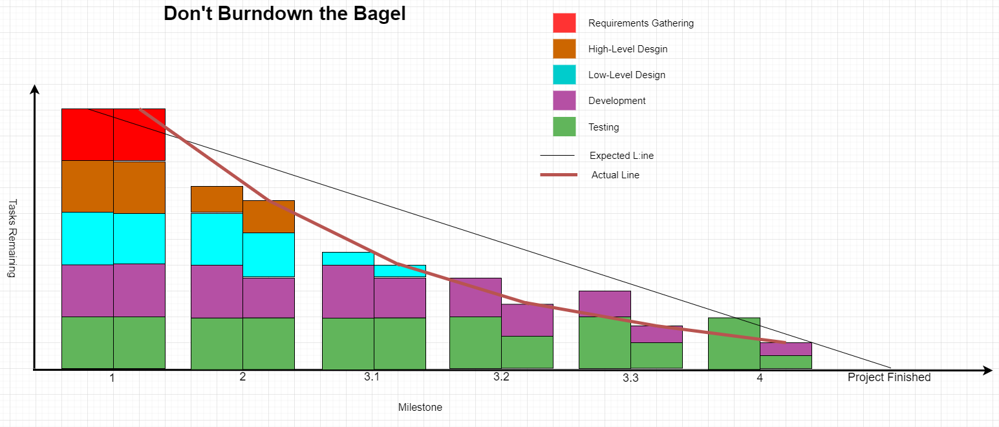

Slide 5
Dan’s Bagels. The Only Place for Bagels.
The program as of right now is mostly working. We have been testing the program as we worked but that testing can become nullified as soon as we add more to the program so we need to test more. The code we submitted for Milestone 3 was imperfect and the things we were graded down for were things that we were close to finishing that are now finished and implemented. Over the next few days we will work through any bugs we might have left over and finish making the project look good and also feel good. Dan’s Bagelry is almost ready for the public. We should probably begin looking for advertising opportunities and figure out how we want to host the website. Investors are probably waiting at the edge of their seats for us to say the word and open the company to the public. Once we finish our code the product will be ready to release and the world can finally realize the joy that comes from ordering a bagel from Dan’s Bagelry, The Only Place for Bagels.

Slide 6
Requirements
By James

Slide 7
Sign Up and Login
Description - This requirement describes how the users are able to create an account, then login automatically after creation of the account. The login system will also allow users to have personal access to Bagel accounts. Whether that be purchasing bagels, managing employees, making bagels, or selling bagels. This system protects unwanted users from accessing important information.
These requirements, use case diagram, prototype model or view, these software tasks, snippet of code as result. Screenshots, from use case and code.

Slide 8
Sign Up and Login
MOSCOW: Must
FURPS - Functionality: This was a core function of the web app. The user would not be able to access their accounts to access paying for bagels as well as adding money to their account.
Audience - User: This relates directly to what the user will see. It also allows the user to access different parts of the site.
Scrum: There were a few scrum task that went into developing this requirement. The main one was the “Login” task. James was in charge of this task. This task was to make sure users would be able to create accounts, as well as access their accounts.

Slide 9
Sign Up and Login
Unit Testing: There were a few tests for this requirement. One of the tests was to make sure if a manager can create a chef, a manager, a cashier, or a customer. Another test was to make sure that a user would be able to create an account for a customer from the basic signup page. Other tests included making sure that each user would be able to login and out of their accounts without losing their information.

Slide 10
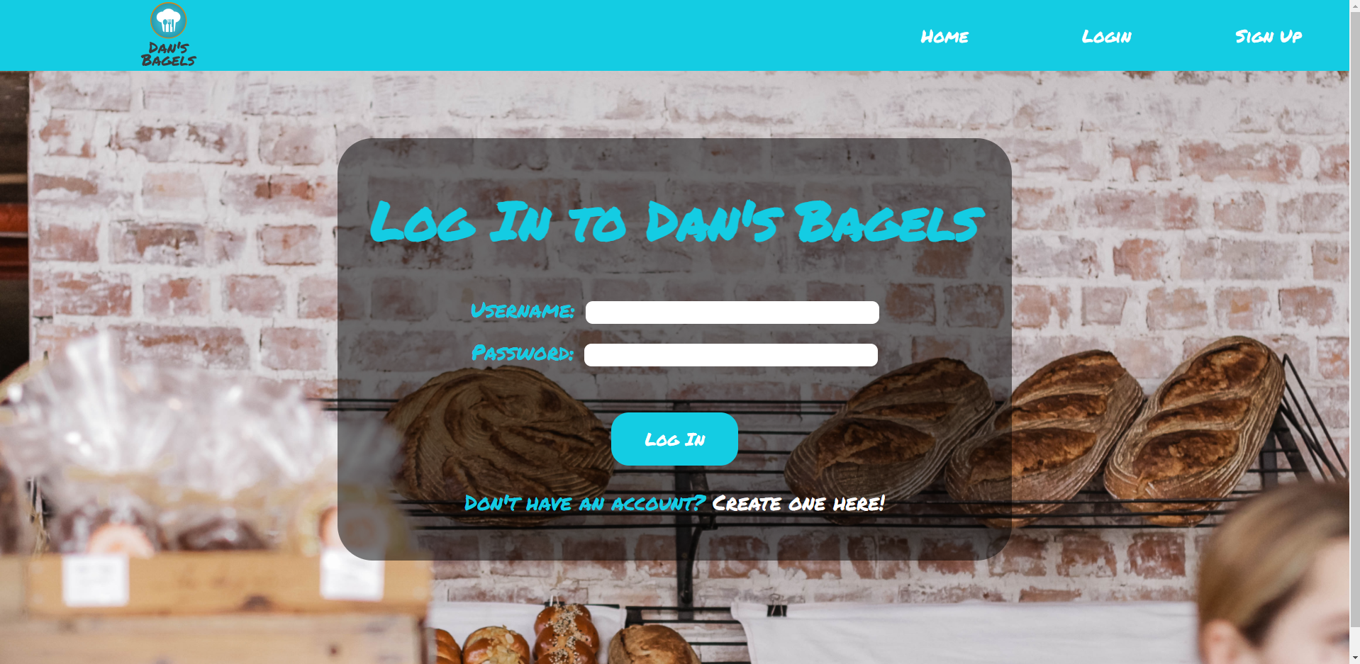
Login Page

Slide 11
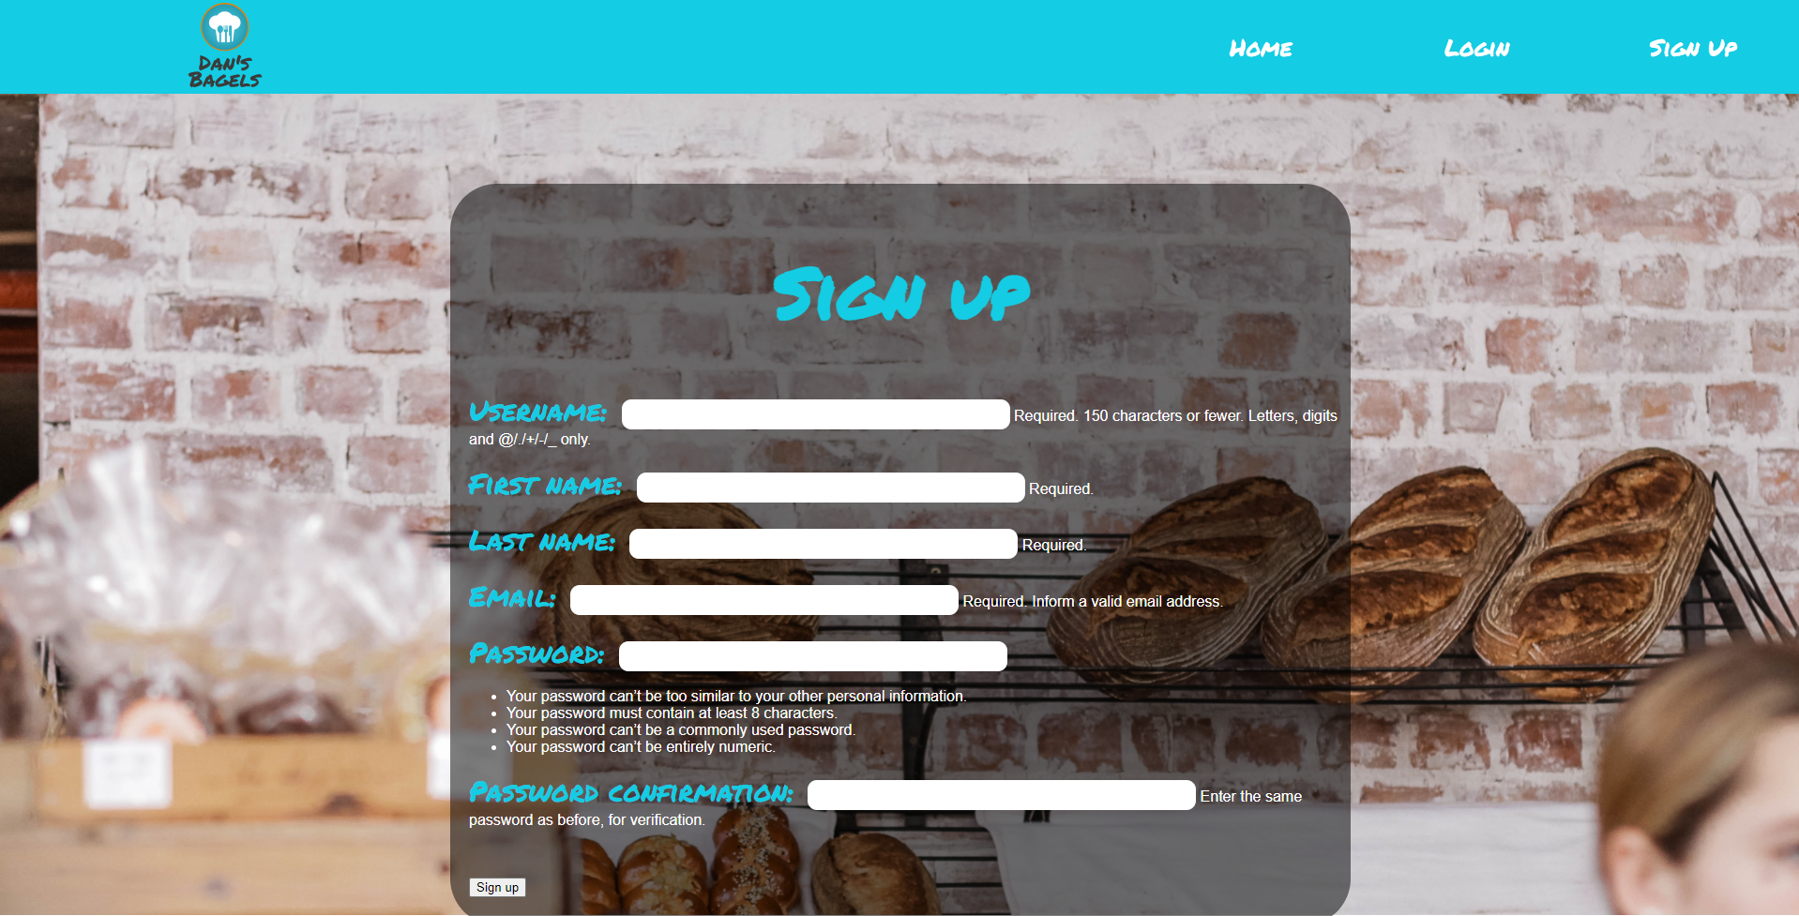
Customer Sign Up Page

Slide 12
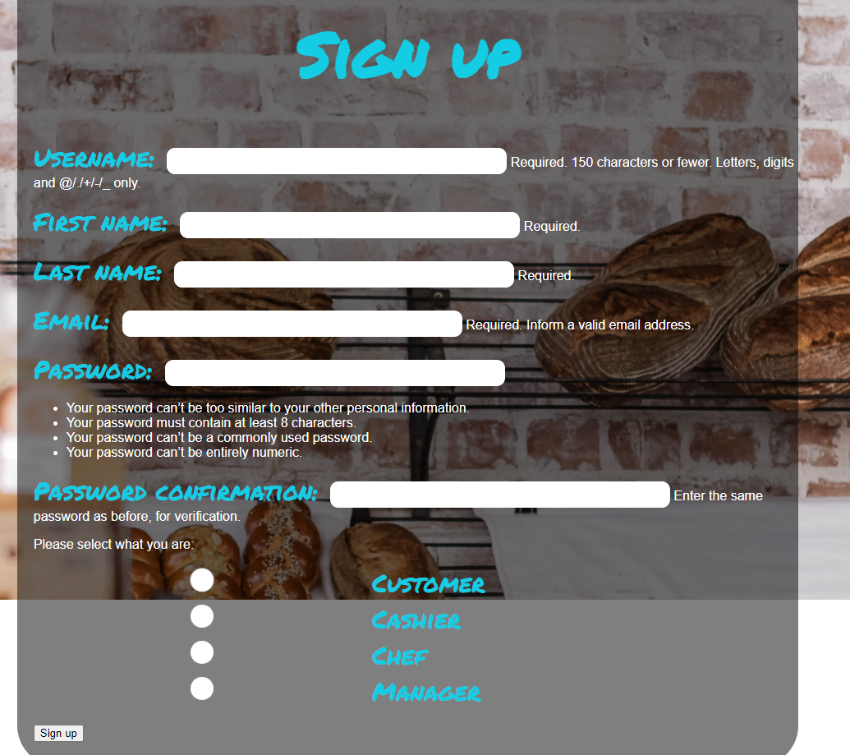
Manager Create User Page

Slide 13
User Roles
Description - This requirement describes how the different users should be able to see different things. For example, the manager should be able to see the order queue, check the inventory and create new employee accounts. The customer, however, should not have these options; they should only be able to build and buy bagels. The chef and cashier should also have different capabilities than the customer. This requirement was core the functionality of the app.

Slide 14
User Roles
MOSCOW: Must
FURPS - Functionality: This was a core function of the web app. The customer could not have the same access as the manager, and vice versa.
Audience - User: This relates directly to what the user will see. It also provides functionality for the users.
Scrum: There were a few scrum task that went into developing this requirement. The main one was the “User Class” task. Dax was in charge of this task. This task was to make sure that certain users had access to certain URLs, and that certain users did not have access to certain URLs.

Slide 15
User Roles
Unit Testing: There were a few tests for this requirement. One of the tests was to see if the right links were appearing for each user. We used test accounts with each role to see if the right links were appearing. Another test was to make sure that users couldn’t access the links even if they knew what they were. This involved logging in as a user that didn’t have access and manually typing in a link that led to somewhere that user didn’t have access.

Slide 16
Customer Views

Slide 17
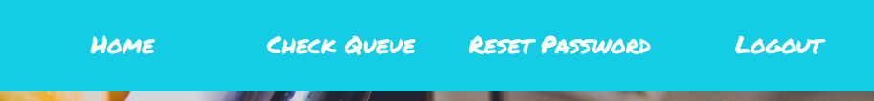
Chef and Cashier Views

Slide 18
Manager Views

Slide 19
The Order Process
This is a key component and requirement of this application as it allows for customer users to be able to look through the menu, select items they want in their order, build their own custom bagel sandwich, and finally checkout their items and submit their order to the bagel shop to be processed. The order process also needs to process the account balance of the user making an order to ensure they have enough money in their account as well as take the money from their balance when they make an order.

Slide 20
The Order Process
MOSCOW: Must
FURPS: Functionality - Without the order process, the application is essentially useless to the bagel shop, with only ability to check the inventory of items.
Audience: User - The customers are the people that are going to be interacting with the main area of the order process. After an order has been placed by a user however, the order is sent to the database where it can be seen by the cashier to be processed.
Scrum: Some of the main scrum tasked that were used to develop the order process were “The Order Class” as well as the “FoodItems Model”. Both are key components of the order process as the FoodItem model populates the database with menu items and the order class stores an array of selected menu items.

Slide 21
The Order Process
Unit Testing:
In order to test the functionality of the order process, several test customer accounts were created as well as a cashier and manager account. The customer accounts were used to create mock orders to ensure no errors occurred and the process was easy to use. Then the cashier and manager accounts were used to check that the orders placed by the customers were reflected in the order queue and that the inventory of items was interacting properly as items from the inventory were sold.

Slide 22
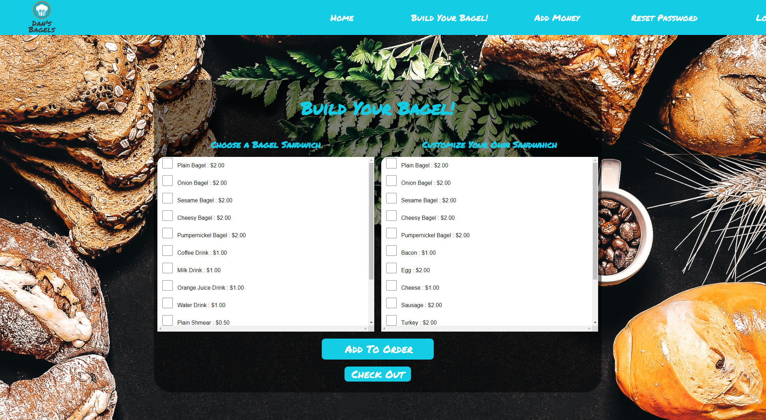
The Build Menu

Slide 23
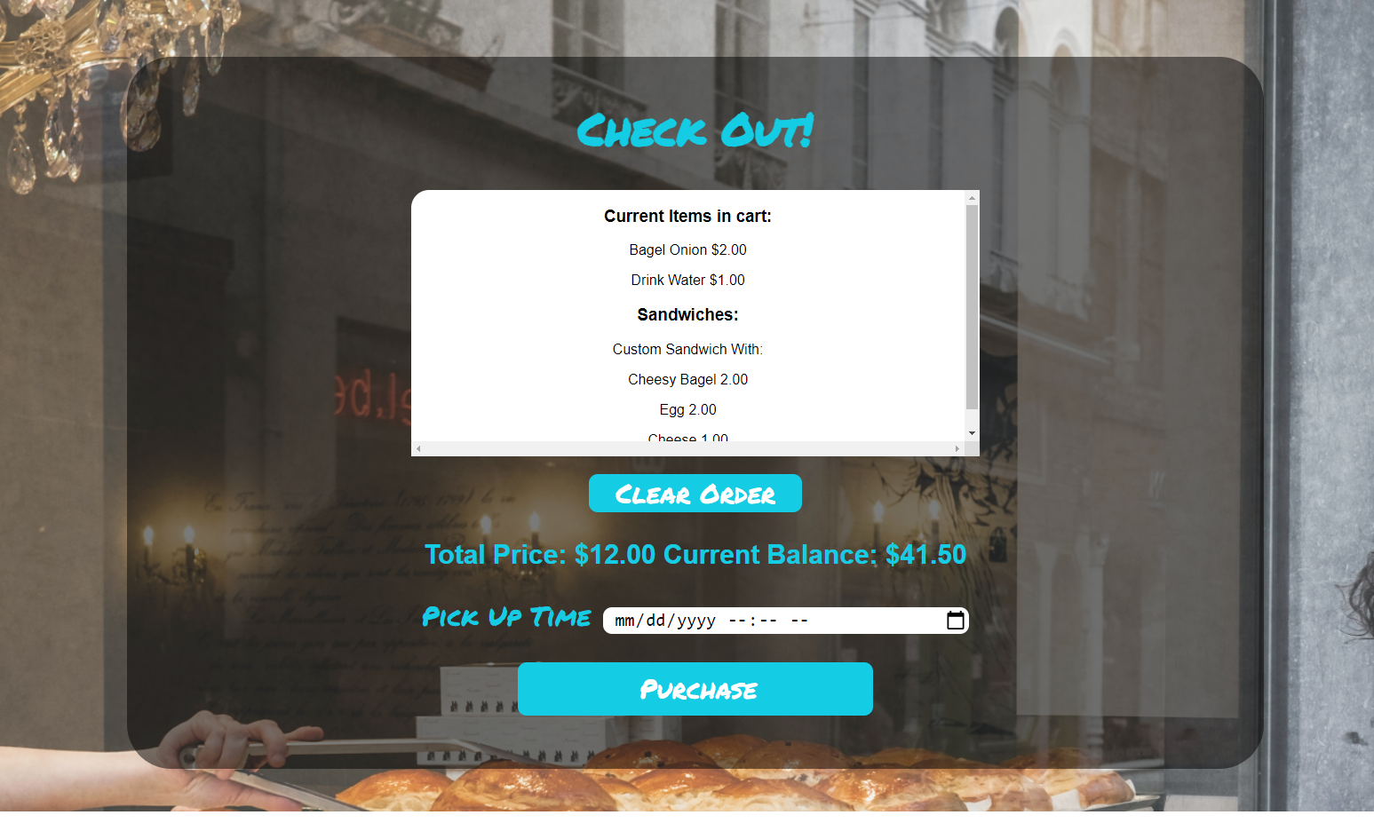
The Checkout Page

Slide 24
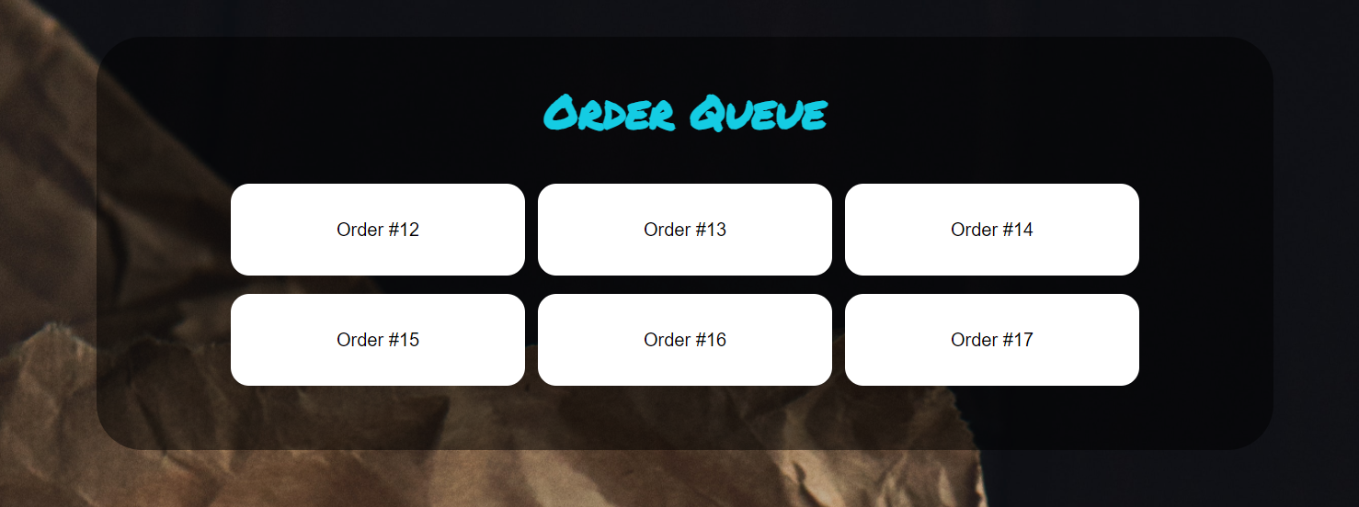
The Queue Page

Slide 25
Resources
Because Knowledge Must Be Free. (n.d.). Retrieved December 02, 2020, from https://overiq.com/
A computer science portal for geeks. (n.d.). Retrieved December 02, 2020, from https://www.geeksforgeeks.org/
Documentation. (n.d.). Retrieved December 02, 2020, from https://docs.djangoproject.com/en/3.1/
Http://www.tangowithdjango.com. (n.d.). Retrieved December 02, 2020, from http://www.tangowithdjango.com/
Where Developers Learn, Share, & Build Careers. (n.d.). Retrieved December 02, 2020, from https://stackoverflow.com/

Slide 26
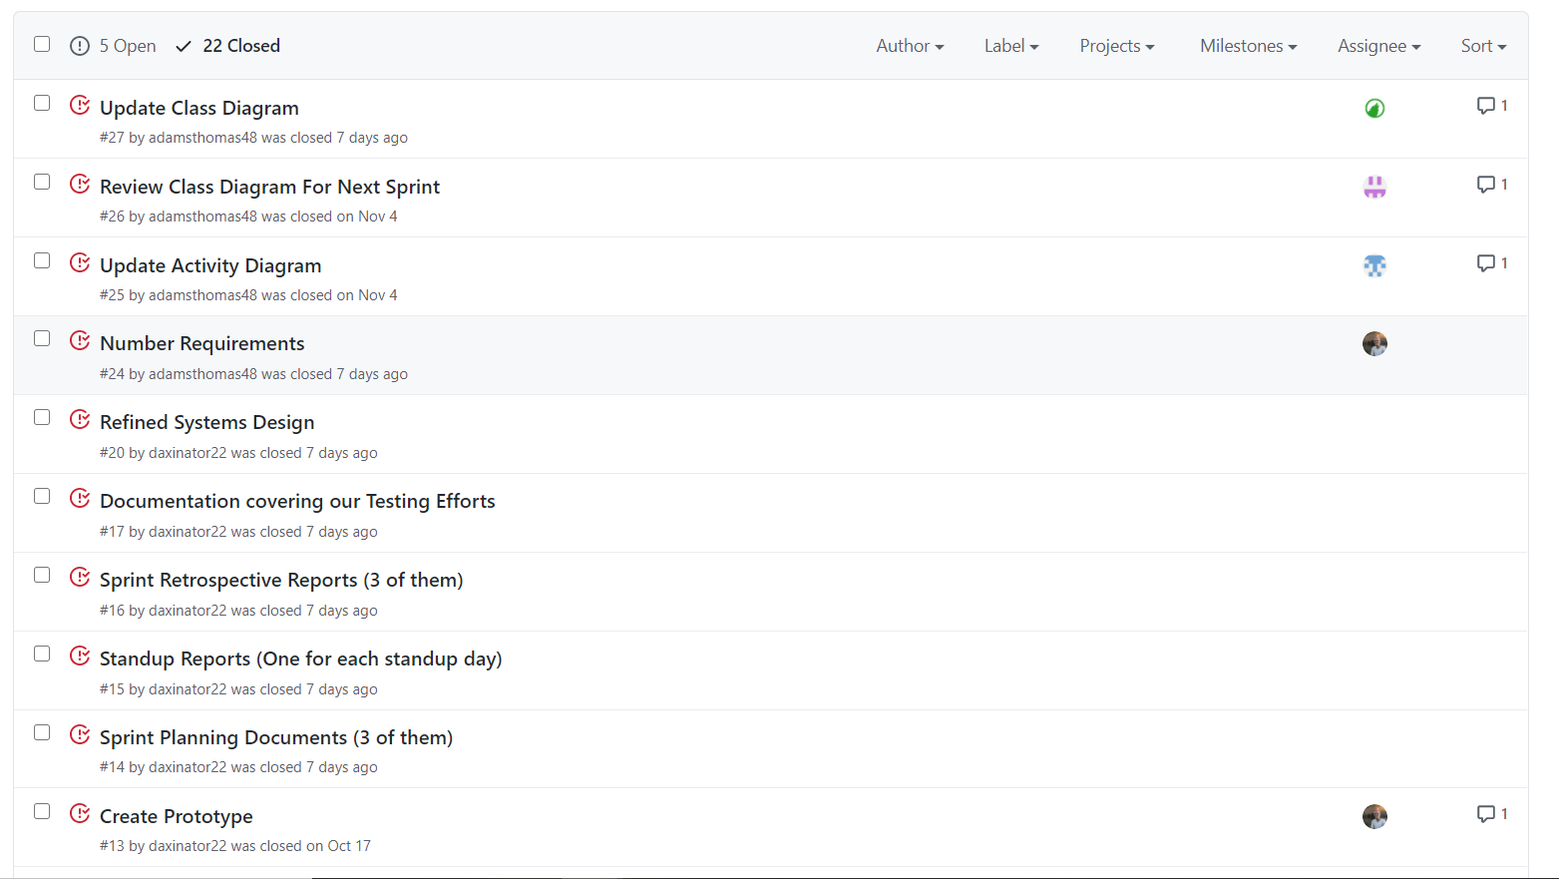
Git Issues
We kept track of issues and goals that needed to be fixed for the project with GitHubs, issues.

Slide 27
Questions?
For Dax

